Slide 1
AngularJS
Trainer: Hoang Vu
Senior Professional Application Architect

Slide 2
Warm up – Break the ice
My role
Over 2 year working on AngularJS
……
Your turn
……

Slide 3
Course Objectives
At the end of this course, you will be able to:
Understand AngularJS framework powers such as dependency injection, MVC model, angular routing, etc.
Know how to extend HTML by directive.
Be aware of scope inheritance and digest cycle of angular .
Be able to build single page application.

Slide 4
Course Audience and Prerequisite
Audience: Software Engineer
Prerequisites:
Basic understanding of HTML/CSS
Hand on working with JavaScript
Notes:
Name some new elements in html?
How many types of selector? Element, id, class.
Log out message ? Console.log => log levels: info, warn error

Slide 5
Assessment Disciplines
Class Participation: 100%
Homework: at least 50%
Mini Test: at least 70%

Slide 6
Duration and Course Timetable
Course duration: 3 sessions (3 hours each)
Break time: 10 mins per hour
Notes:
Course Duration: 9 hrs
Break 10 minutes per an hour

Slide 7
Further Reference
AngularJS official site
https://docs.angularjs.org/guide
https://docs.angularjs.org/api
https://ui-router.github.io/ng1/tutorial/helloworld
Notes:
Writing unit test for web application using AngularJS

Slide 8



Set Up Environment
Brackets
Notes:
Text Editor
Browser
Brackets for local server

Slide 9
Agenda
Introduction
Model-View-Controller & Data binding
Bootstrap Angular
Core modules
Exercise & Homework

Slide 10
Course Administration
In order to complete the course you must:
Sign in the Class Attendance List
Participate in the course
Provide your feedback in the End of Course Evaluation

Slide 11
1. Introduction
Notes:
Any questions before we start?

Slide 12




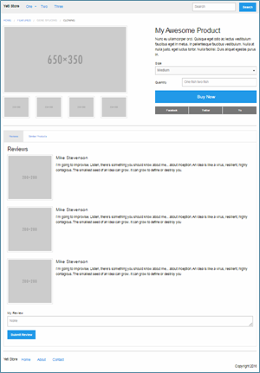
Server Rendering Concept
Introduction
Request
M
V
C
Response
Notes:
Server will render and response full html content.
Server-side pros:
Search engines can crawl the site for better SEO.
The initial page load is faster.
Great for static sites.

Slide 13
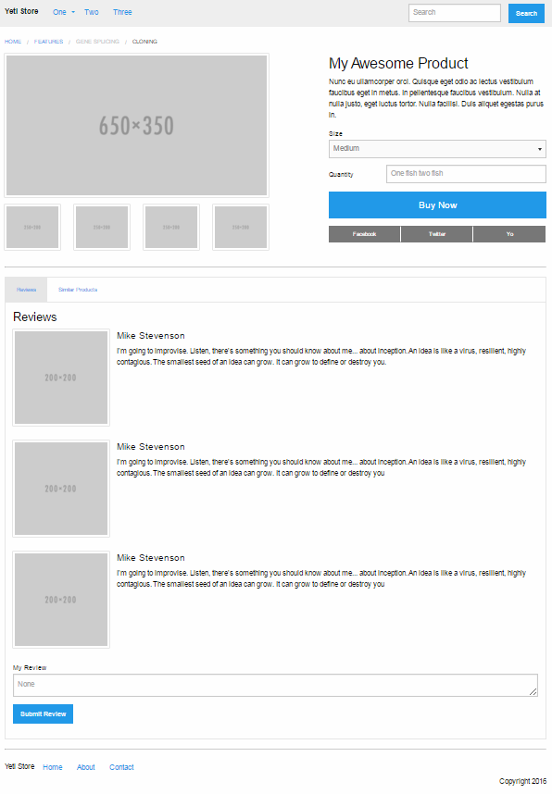
Limitations
Introduction
Header and Footer do not change on all pages.
Only content values change.
Notes:
Any idea resolve that problem?
Server-side cons:
Frequent server requests.
An overall slow page rendering.
Full page reloads.
Non-rich site interactions.

Slide 14
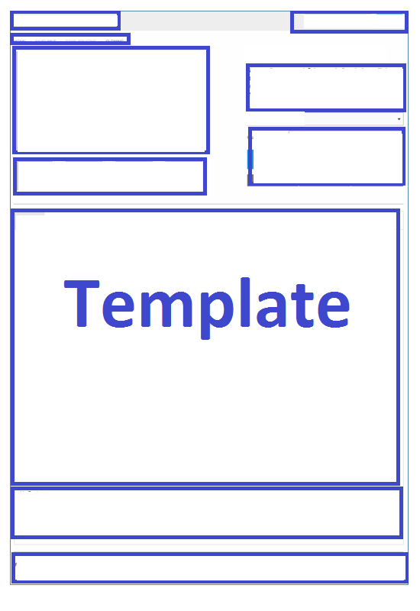





Client Rendering Concept
Introduction
Request
Template
Server
Response
M
Browser
Web Service
Server
V
C
Request
Response
Notes:
First request to server in client side needs 2 round trips before content can be displayed. After that, every subsequent page load will be blazingly fast
Client-side pros:
Rich site interactions
Fast website rendering after the initial load.
Great for web applications.
Robust selection of JavaScript libraries.
Client-side cons:
Low SEO if not implemented correctly.
Initial load might require more time.
In most cases, requires an external library.

Slide 15




Introduction
Client Rendering Frameworks
Notes:
AngularJS
ReactJS By Facebook
Ember.js based on the Model–view–viewmodel (MVVM) pattern

Slide 16
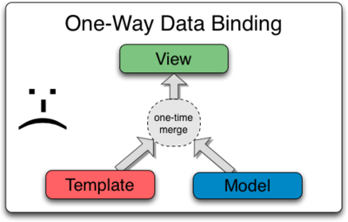
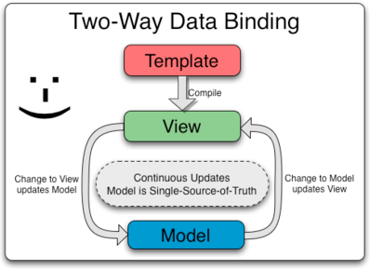
What is Angular?
Introduction
A JavaScript framework that is perfect for Single Page Application
With client rendering approach and two-way data binding
Can extend HTML with new attributes
Notes:
One way data flow means that the model is the single source of truth. Changes in the UI trigger messages that signal user intent to the model (or “store” in React). Only the model has the access to change the app’s state.
https://stackoverflow.com/a/37566693/3758596
In two way data binding: changing data changes view and vice versa — updating input inside view updates data.
In on way data flow: updating data updates view but updating input in view will not update data unless programmer do it explicitly by attaching listener to input which will update data

Slide 17
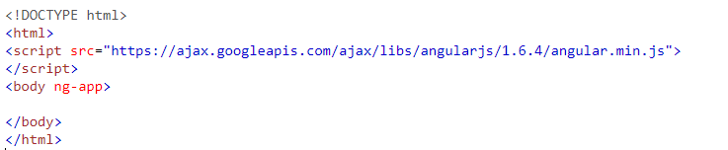
Set up AngularJS
Even-numbered are stable such as 1.0.x, 1.2.x, etc. , odd-numbered are for development only such as 1.1.x, 1.3.x, etc.

Slide 18
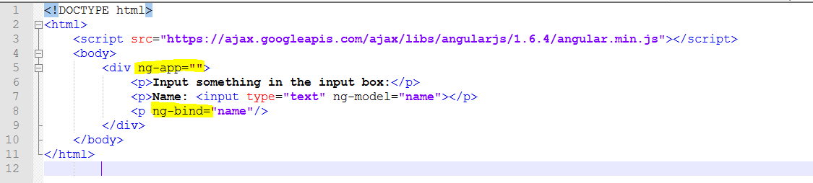
Example 1: Hello world
Notes:
Angular JS directives are HTML attributes with an ng prefix
ng-app defines an angular application
ng-model directive binds value of HTML controls (inputs, select, textarea) to application
ng-bind directive binds application data to the HTML view which is the same as {{ }} expression
<!doctype html> <html ng-app> <head> <script src="http://ajax.googleapis.com/ajax/libs/angularjs/1.0.7/angular.min.js"></script> </head> <body> <div> <!-- input your code here --> </div> </body> </html>

Slide 19
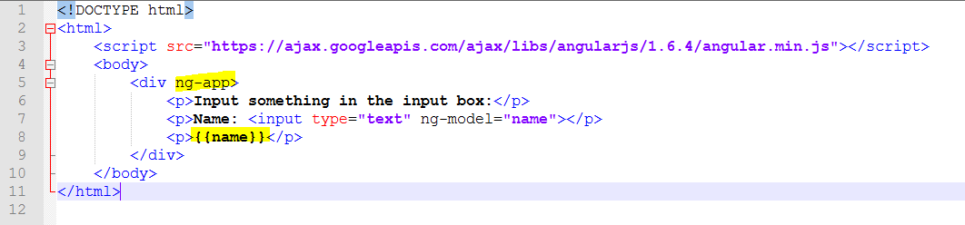

Example 1 equivalent
Notes:
Ng-app is equivalent to ng-app=“” but different from ng-app=“myAngularApp”

Slide 20
Angular Expression vs. JavaScript Expression
Points in common:
Can contain literals, operations, and variables
Only Angular Expression:
Does not support loops, conditions, and exceptions
Support Filters
Can be written inside HTML

Slide 21
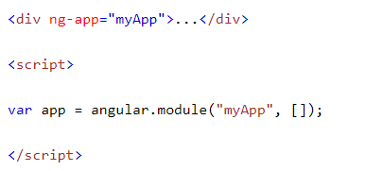
AngularJS Modules
An AngularJS module define an application
It is the container of other components such as controllers, directives.
Created by using global function angular.module()
Notes:
It is recommended to put the angular lib script in the head section or body section of HTML for the angular.module to be compiled successfully

Slide 22
Demo
Hello World application

Slide 23
2. MVC and Data binding

Slide 24
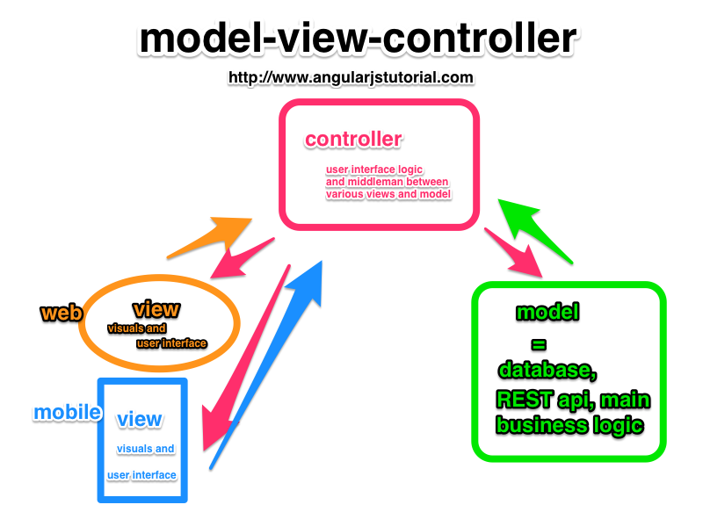
MVC
Notes:
Group Presentation on MVC Pattern

Slide 25
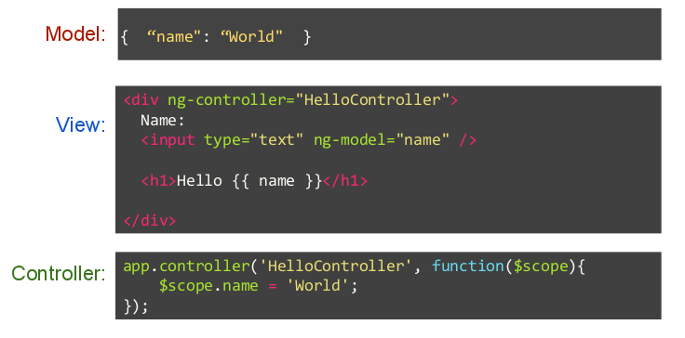
MVC
Angular MVC Pattern
Notes:
Group Presentation on MVC Pattern
Angular is MVC or MVVM? https://stackoverflow.com/questions/13329485/what-does-mvw-stand-for
Roles of each component
1. controller: get inputs, call functions that perform business rules and share data with view via $scope
In Angular, the logic is performed in a service and we inject that server into the controller.
Using the service, angular controller obtains data and set it on $scope objects
=> controller only aware the scope not the view
==> this allow us to change the whole UI from web view to mobile view while keeping the business logic because controller is completely separate from the view
2. model: represent the business data that drives the UI. UI is a projection of model data at any given time through the view
3. view: only concerned with displaying data and is decoupled from the business logic. It should update itself whenever underlying data model changes

Slide 26
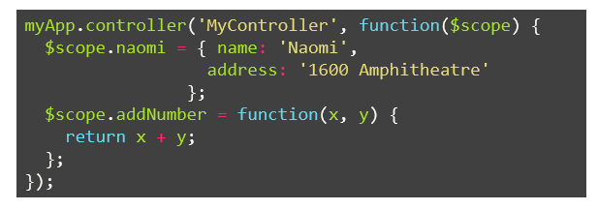
Controllers
Create its own $scope
Expose methods and variables for views through the $scope
Unlike services, there can be many instances in an app
Notes:
Angular application is controlled by controllers

Slide 27
Scopes
Each controller have its own $scope which is an object that refers to the Model in MVC
It is the glue between View and Controller.
Only one $rootScope for an application

Slide 28
Introduction
Data Binding
Step 1
Empty Values
Full Values
Change a Value
Step 3
Step 2

Slide 29
Core
Data Binding Step 1
Empty Values

Slide 30
Core
Data Binding Step 2
Full Values

Slide 31
Core
Data Binding Step 3
Change a Value

Slide 32
Introduction
Data Binding
Step 1
Empty Values
Full Values
Change a Value
Step 3
Step 2

Slide 33
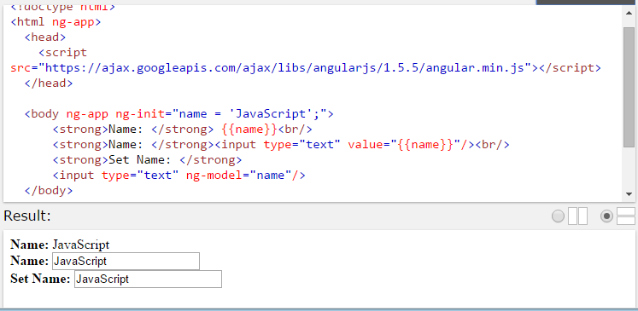
Data Binding
Example 2: Data binding
Model (Model For View)
Angular Expression
Input new value
Notes:
ng-init initializes AngularJS application variable. Using ng-init is not very common
Angular expression calculate the result then put the result into the place. {{ 5 + 5 }} => 10.
It has same effect as eval but the mechanism is different

Slide 34
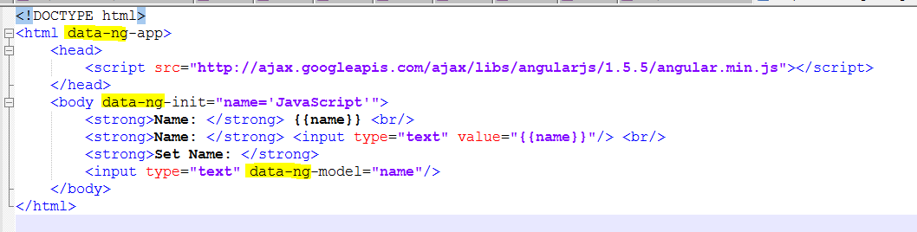
Data Binding
Equivalent Example 2 with data prefix
Notes:
data prefix allow us to have a valid HTML when validating HTML
https://www.freeformatter.com/html-validator.html
https://stackoverflow.com/a/24335230/3758596

Slide 35
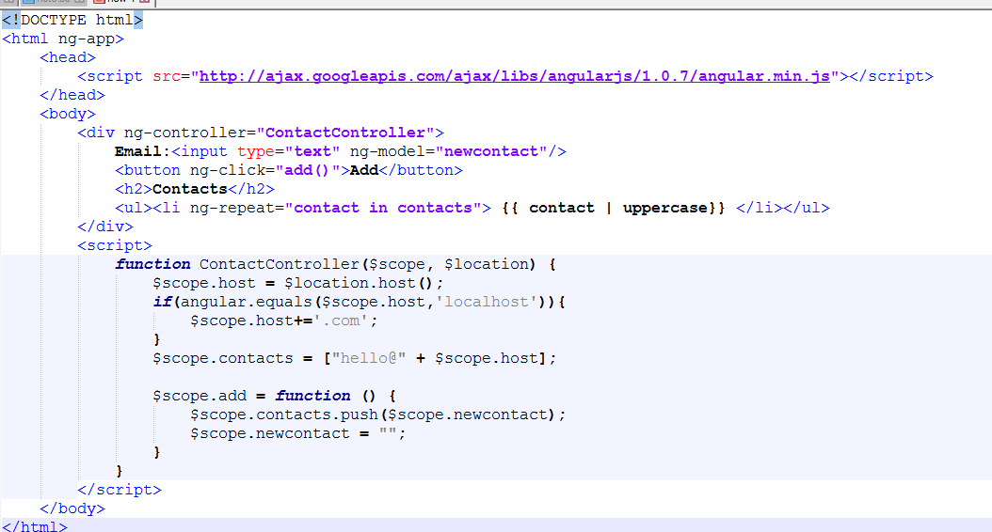
MVC
Example 3: Define a controller
Model
(Model For View)
Notes:
<!doctype html> <html ng-app> <head> <script src="http://ajax.googleapis.com/ajax/libs/angularjs/1.0.7/angular.min.js"></script> </head> <body> <div> <!-- input your code here --> </div> </body> </html>

Slide 36
Demo
Data Binding

Slide 37
3. Bootstrap Angular
Angular initialization process

Slide 38
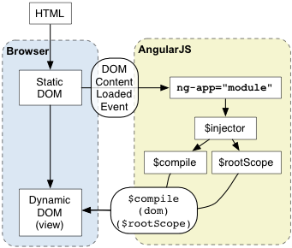
MVC
How Angular works
Upon DOMContentLoaded event, Angular will look for ngApp directive indicating application root. When the directive is found, Angular will:
Load module and create application $injector which will be used for dependency injection
Compile DOM with ngApp as root of compilation => this allows us to have only portion of DOM treated as Angular application
Notes:
Angular initializes automatically upon DOMContentLoaded event or when the angular.js script is evaluated if at that time document.readyState is set to 'complete'.
At this point Angular looks for the ng-app directive which designates your application root. If the ng-app directive is found then Angular will:
- load the module associated with the directive.
- create the application injector
- compile the DOM treating the ng-app directive as the root of the compilation.
This allows you to tell it to treat only a portion of the DOM as an Angular application
Every application has a single root scope. All other scopes are descendant scopes of the root scope. Scopes provide separation between the model and the view, via a mechanism for watching the model for changes. They also provide an event emission/broadcast and subscription facility.
$injector is used to retrieve object instances as defined by provider, instantiate types, invoke methods, and load modules.
The $provide service has a number of methods for registering components with the $injector. Many of these functions are also exposed on angular.Module.
https://docs.angularjs.org/guide/bootstrap
https://docs.angularjs.org/api/auto/service/$injector

Slide 39
Bootstrap automatically
<html ng-app="myApp">
<head>
...
</head>
<body ng-app="myApp">
...
<div id="content" ng-app="myApp">
...
</div>
...
</body>
</html>

Slide 40
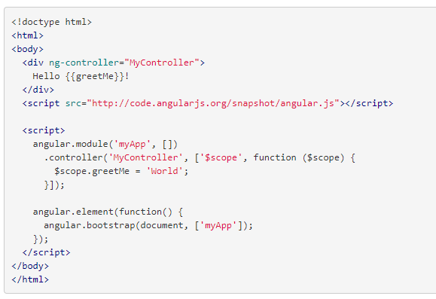
Example 4 Bootstrap manually

Slide 41
Module and Multiple Controllers
Module
Controller1
Controller2
Controller3

Slide 42
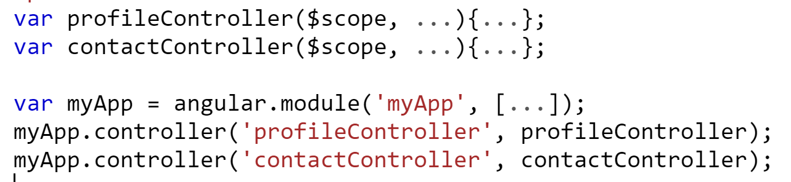
Step 1: Create Module. Step 2: Add controllers to the module

Slide 43
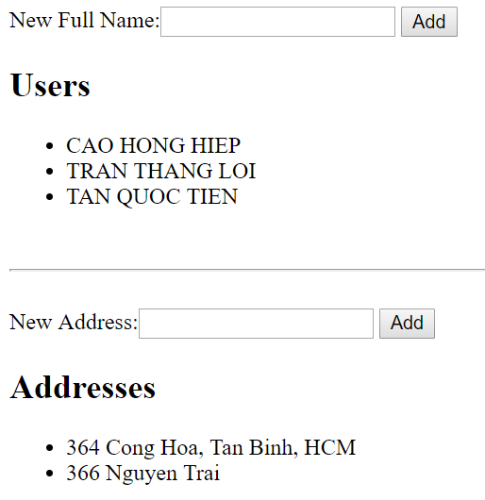
Example 5: Module and Multiple Controllers

Slide 44
$rootScope
Module
$rootScope
Controller1
Controller2
Controller3
$scope
$scope
$scope
Notes:
Each application only have one rootScope

Slide 45
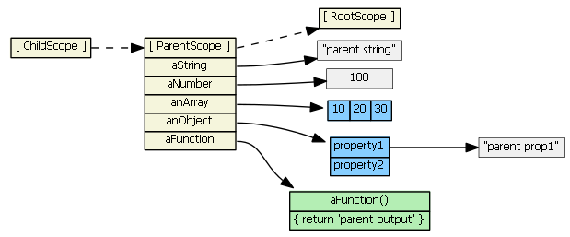
JavaScript Prototypal Scope Inheritance
Notes:
https://github.com/angular/angular.js/wiki/Understanding-Scopes
Always true
childScope.aString === 'parent string'
childScope.anArray[1] === 20
childScope.anObject.property1 === 'parent prop1'
childScope.aFunction() === 'parent output'

Slide 46
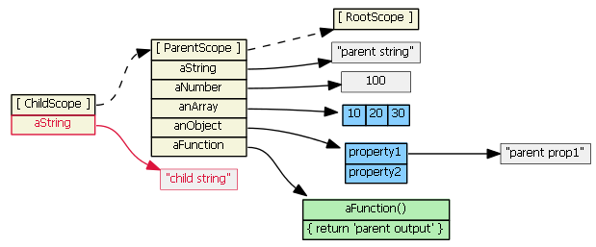
JavaScript Prototypal Scope Inheritance
Notes:
childScope.aString = 'child string‘ => shadows the parent attribute because it is primitive

Slide 47
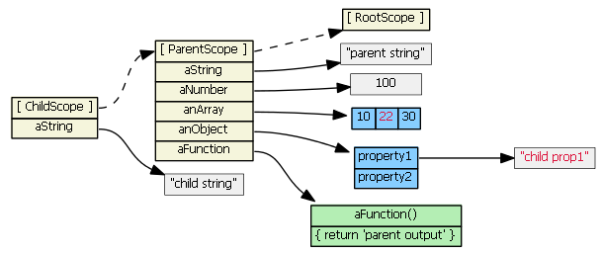
JavaScript Prototypal Scope Inheritance
Notes:
The below will no effect the parent scope instead of create new array
childScope.anArray[1] = 22
childScope.anObject.property1 = 'child prop1'

Slide 48
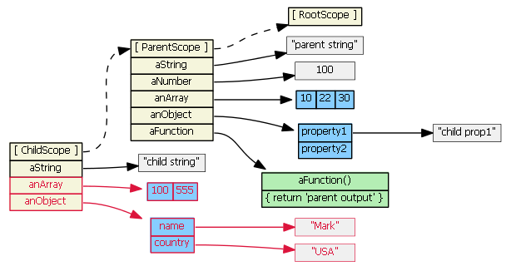
JavaScript Prototypal Scope Inheritance
Notes:
Below will create new object because those are undefined in childScope
childScope.anArray = [100, 555]
childScope.anObject = { name: 'Mark', country: 'USA' }

Slide 49
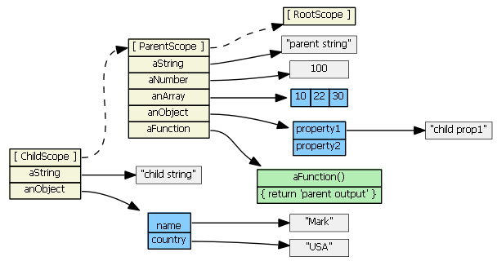
JavaScript Prototypal Scope Inheritance

Slide 50
Angular Scope Inheritance
There are four types of scopes:
normal prototypal scope inheritance -- ng-include, ng-switch, ng-controller, directive with scope: true
normal prototypal scope inheritance with a copy/assignment -- ng-repeat. Each iteration of ng-repeat creates a new child scope, and that new child scope always gets a new property.
isolate scope -- directive with scope: {...}. This one is not prototypal, but '=', '@', and '&' provide a mechanism to access parent scope properties, via attributes.
transcluded scope -- directive with transclude: true. This one is also normal prototypal scope inheritance, but it is also a sibling of any isolate scope.
Notes:
normal prototypal scope inheritance – ng-if, ng-include, ng-switch, ng-controller, directive with scope: true, each loop in ng-repeat
Best practice always use “object.property” inside ng-model instead of just “property”

Slide 51
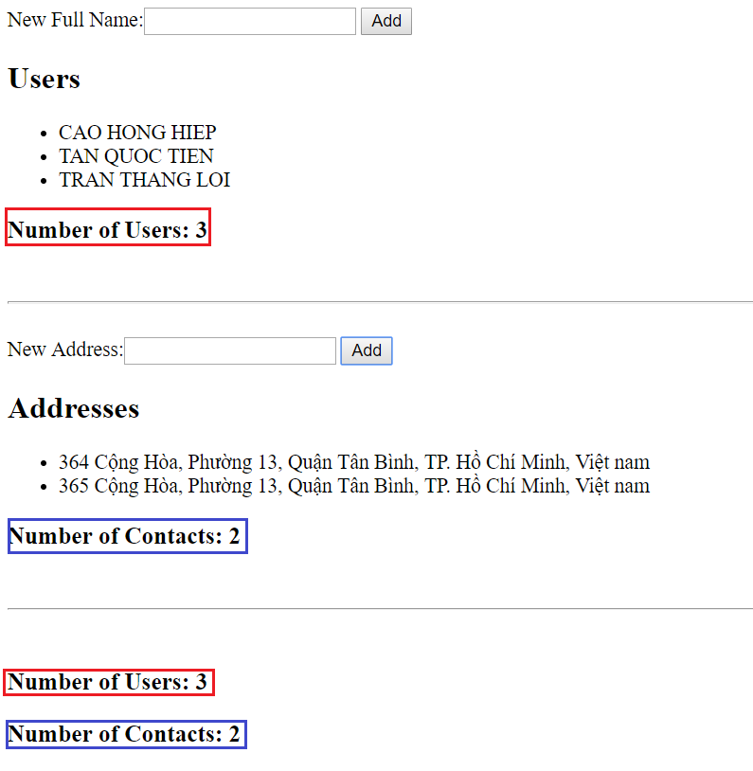
Example 6: Root Scope

Slide 52
Section 1: Q&A

Slide 53
4. Core modules
Notes:
https://docs.angularjs.org/api

Slide 54
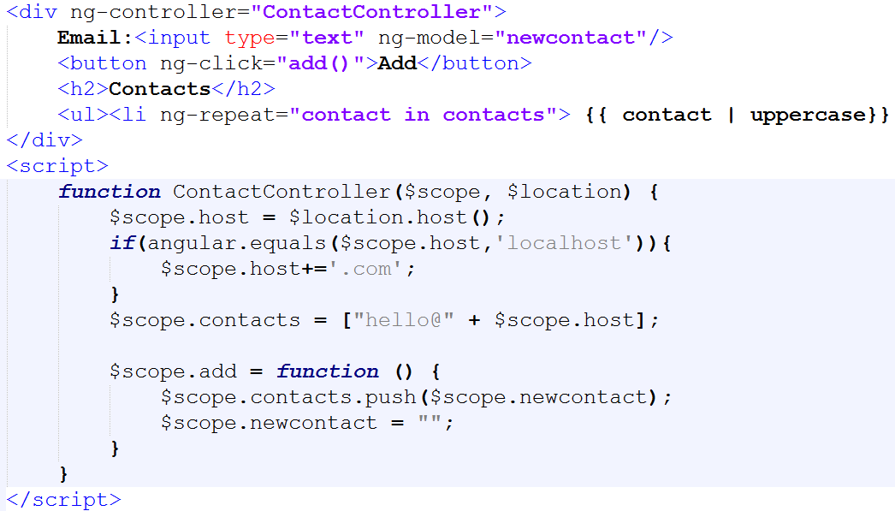
Directive
Core Modules Overview
Filters
Global API Functions
Services, Factories

Slide 55
Core
Angular ng Core Modules
Directive
Services
Filters
Routing
Global API

Slide 56
Core
Directive
Directive
Structure
ng-model
ng-bind
Event
ng-click
Mapping
ng-app
ng-view
Behavior
ng-change
ng-repeat
Binding
...
ng-controller
...
ng-if
ng-show
...
ng-include
...
…
Notes:
Extend HTML with new attributes called Directives. It can use change style, bind data, call action,..
Directive:
ng-app: root element of the AngularJS application.
ng-controller: attaches a controller class to the view.
ng-model: binds the value input, select, textarea.
ng-bind: replace the text content of the specified HTML element.
ng-repeat: loop item in a collection.
ng-show/ng-hide vs ng-if https://stackoverflow.com/a/21870119/3758596
ng-disabled: disabled attribute of HTML elements
ng-click: call action when element is clicked.
ng-change: call action when value of element is changed.
……………..
Refer: https://docs.angularjs.org/api/ng/directive

Slide 57
Introduction
Data Binding
Step 1
Empty Values
Full Values
Change a Value
Step 3
Step 2

Slide 58
Core
Data Binding Step 1
Empty Values
Full Values
Change a Value

Slide 59
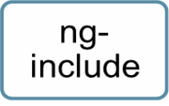
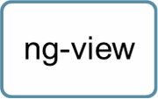
Core
Directive
Updated Values
Change location(home, contact,…)
One of Templates (home-template.html, contact-template.html,…) will be replaced here.
Notes:
https://www.w3schools.com/angular/tryit.asp?filename=try_ng_routing

Slide 60
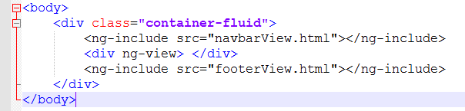
Directive

Slide 61
Core
Data Binding Step 2
Empty Values
Full Values
Change a Value

Slide 62


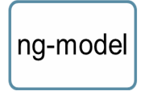
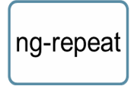
Core
Directive
ng-bind
Full Values
Notes:
ng-bind === {{}}
Using ng-bind in case of index file to avoid seeing {{ }} in first load

Slide 63
Core
Data Binding Step 3
Empty Values
Full Values
Change a Value

Slide 64

Core
Directive
ng-click
Automatic bind value to model when onchange
Call function when Click button

Slide 65
Services
Services are used to encapsulate repetitive logic.
Services are always singletons ==> services are great for storing successful login user info
Services are lazily instantiated ==> it is only instantiated when encounter a component is using it as dependency.
Notes:
This is the core collection of services which are used within the DI of your application.
Services:
$http: communication with the remote HTTP servers via XMLHttpRequest.
$resource: creates a resource object that lets you interact with RESTful server-side data sources.
$document: jqLite wrapper for the browser's window.document
$window: A reference to the browser's window object.
$rootScope: Root model of Application.
………….
https://docs.angularjs.org/api/ng/service

Slide 66
Core
Services
Services
DOM
$rootScope
Async
BOM
$window
$document
Ajax
$q
$http
Model
...
$location
...
$resource
...
$rootElement
...
$log
…
$scope
Notes:
This is the core collection of services which are used within the DI of your application.
Services:
$http: communication with the remote HTTP servers via XMLHttpRequest.
$resource: creates a resource object that lets you interact with RESTful server-side data sources.
$document: jqLite wrapper for the browser's window.document
$window: A reference to the browser's window object.
$rootScope: Root model of Application.
………….
https://docs.angularjs.org/api/ng/service

Slide 67
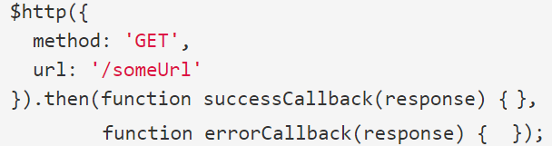
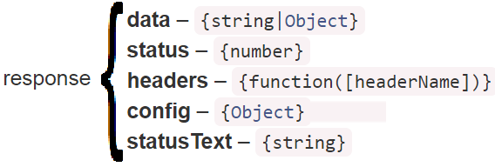
Service $http usage
Core
$http
$http.get
$http.head
$http.post
$http.put
$http.delete
$http.jsonp
$http.patch

Slide 68
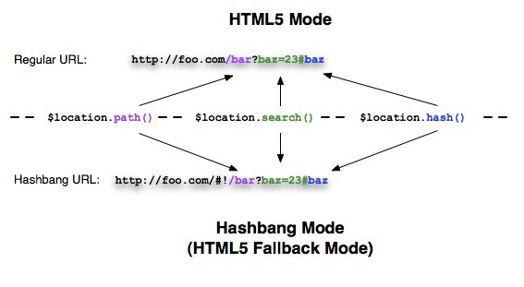
Service $location usage
Core

Slide 69
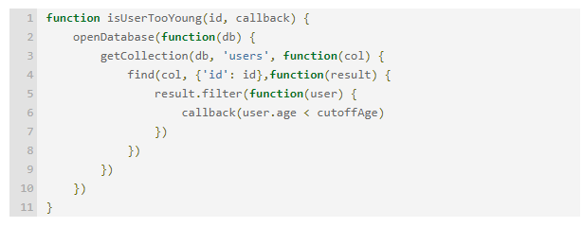
Problem with Callback
Core
Notes:
https://www.quora.com/Whats-the-difference-between-a-promise-and-a-callback-in-Javascript

Slide 70
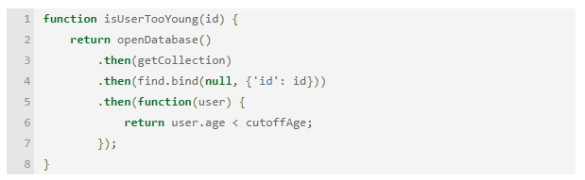
Solved with Promise
Core
Notes:
https://www.quora.com/Whats-the-difference-between-a-promise-and-a-callback-in-Javascript
https://codeburst.io/javascript-promises-explained-with-simple-real-life-analogies-dd6908092138

Slide 71
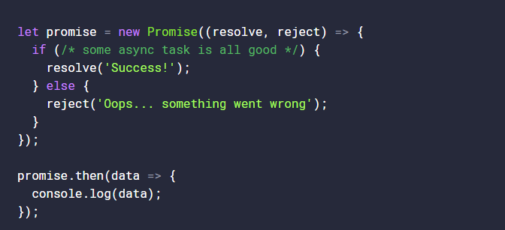
ES2015 Promise
Core
Notes:
https://toddmotto.com/promises-angular-q

Slide 72
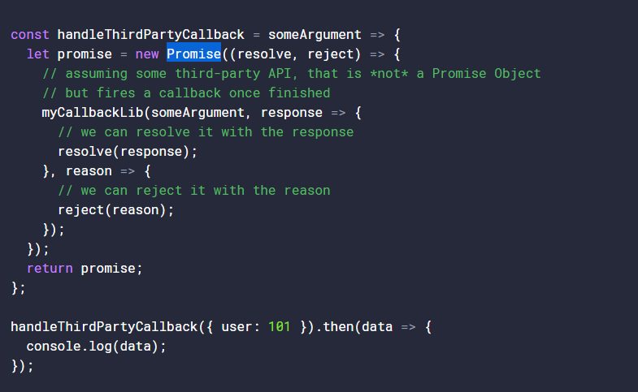
ES2015 Promise
Core
Notes:
https://toddmotto.com/promises-angular-q

Slide 73
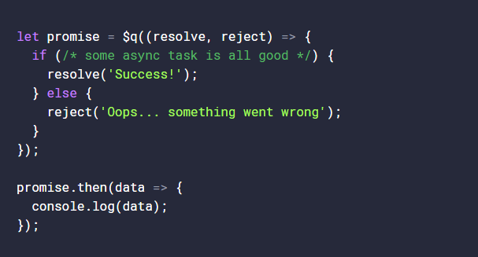
Service $q usage
Core

Slide 74
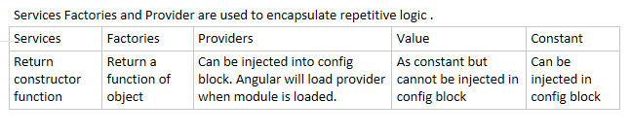
Types of Custom Services
Notes:
Factory is the same as Services except that we can determine which object to return based on certain parameters
Provider when defined must have $get function
There is one caveat with constants that can cause them to be editable and that is using anything other than a primitive. Values other than primitives are treated as objects. When using objects with a constant they can be modified, which for a constant makes no semantic sense whatsoever.
http://www.simplygoodcode.com/2015/11/the-difference-between-service-provider-and-factory-in-angularjs/index.html

Slide 75
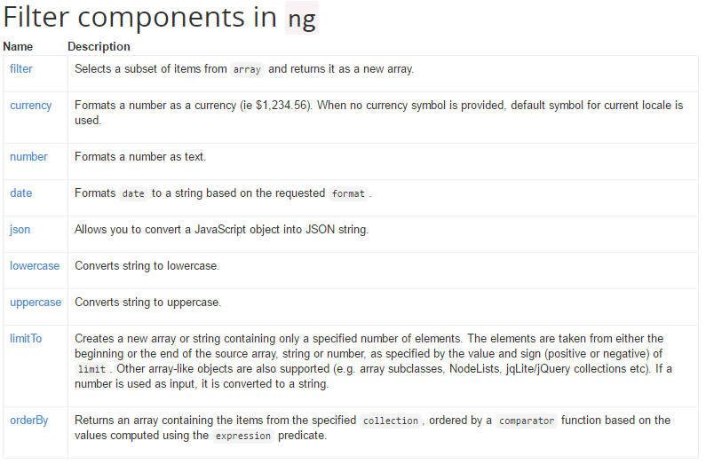
Filters – Built-in Filters

Slide 76
Filters – Custom Filters
A filter is used to format the value of an expression for displaying to the user
Uppercase a value,
Filter search results, etc.
Can be used in view templates, controllers or services
Create a custom filter
{{user.name | upperCase}}
myApp.filter(‘upperCase’, function() {
return function(text){
return text.toUpperCase();
}
});
Notes:
76

Slide 77
Routing in Angular
Deep Linking is a URL that allows navigate directly to a specific resource like a web page or a file.
http://example.com/path/page
http://example.com/
AJAX application
Contents of AJAX sites are loaded by script
Can’t bookmark or history browsing (back or forward)
Solutions: use ‘#’ in the URL
http://www.example.com/home.html#introduction
Browser would not refresh the page when the hash is changed.
JavaScript need to listen for the change of the hash in the navigation bar and do actions.
<a href="#C4">See also Chapter 4.</a>

Slide 78
Routing in Angular (cont.)
Application routes in Angular are provided by $route service
Wire controllers, view templates, and the current URL location in the browser
It watches $location.url() and map the path to an existing route definition
Used in conjunction with the ngView directive
<body>
<div ng-view></div>
</body>
Configure $route service
Via $routeProvider in config block of module
when(path, route): adds a new route definition to the $route service.
otherwise(params): sets default route definition

Slide 79
Routing Example
phonecatApp.config(['$routeProvider',
function($routeProvider) {
$routeProvider.
when('/phones', {
templateUrl: 'partials/phone-list.html',
controller: 'PhoneListCtrl'
}).
when('/phones/:phoneId', {
templateUrl: 'partials/phone-detail.html',
controller: 'PhoneDetailCtrl'
}).
otherwise({
redirectTo: '/phones'
});
}]);
Notes:
Check the take home example of route

Slide 80
Global API Functions
https://docs.angularjs.org/api/ng/function/angular.isFunction
………

Slide 81

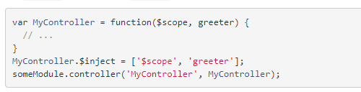
3 Ways for injecting dependencies
Using inline array annotation - the recommended
Using the $inject property annotation

Slide 82

3 Ways for injecting dependencies
3. Implicitly from the function parameter names (has caveats)
Careful: If you plan to minify your code, your service names will get renamed and break your app.

Slide 83
Section 2: Q&A

Slide 84
5. Exercises & Homework

Slide 85
Exercise 1, 2 and 3
Follow the “Class 3 Exercises.docx”

Slide 86
Exercise 4 watch and apply
Expression are registered with a watcher that is put in watch list
$scope.$watch: to put expression into watch list
$scope.$apply: to trigger $digest cycle
$scope.$watch('elapsed', function(){
if ($scope.elapsed > 0)
$scope.text = $scope.text + " World";
});
setTimeout(function(){
var delta = (new Date().getTime() - $scope.startedTime.getTime());
$scope.elapsed = Math.round(delta / 1000);
$scope.$apply();
}, 3000);
Notes:
https://www.thinkful.com/projects/understanding-the-digest-cycle-528/
If the expression in watch list changed, listener function get called

Slide 87
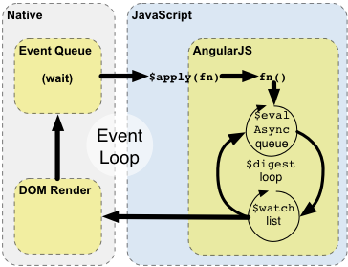
Browser Event Loop and Angular Digest Cycle
Notes:
After Angular reaches the last watcher that has been registered in the scope, the digest cycle is not quite done. Angular runs through all of the watchers again to see if any changed values in the first journey through the list of watchers has caused any other watched expressions to change. Angular will continue running through the list of watchers up to 10 times. If it finds that no values have changed, the digest cycle is complete, and the DOM will be updated accordingly. If at the end of 10 trips through there are still changed values, Angular will throw an error.

Slide 88
Apply is needed when
Object mutation is outside of angular context such as onClick event, setTimeout event
Instead of those native function, use ng-click and $timeout service from Angular then apply is called by angular itself
Notes:
AngularJS does not use any kind of polling mechanism to periodically check for model changes
Event loop happens inside angular context such as ng-click, $http, $timeout will trigger the cycle without need of $apply
Can anyone perform an equivalent of exercise 4 without apply?

Slide 89
Exercise 5 scope event
Scopes can propagate events with other scope by using
$broadcast: sends an event downwards from parent to child controllers
$emit: sends an event upwards from the current controller to all of its parent controllers
An event raised by $broadcast() and $emit() can be handled by wiring an event handler using $on() method

Slide 90
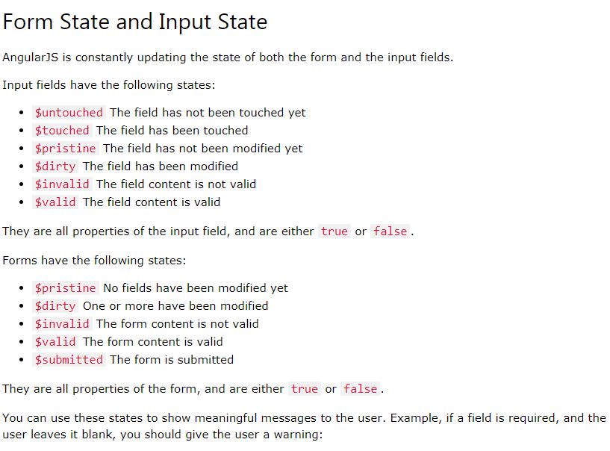
Notes:
https://www.w3schools.com/angular/angular_validation.asp

Slide 91
Exercise 6 form validation
formName.inputName.$error
.required
.email -- to check empty
formName.inputName.$dirty
formName.$invalid

Slide 92
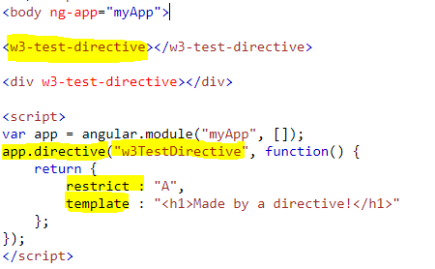
Custom Directive
camelCase in name
Separated with – when invoking
Restrict can be
Element E
<w3-test-directive></w3-test-directive>
Comment M
<!-- directive: w3-test-directive -->
Attribute A
<div w3-test-directive></div>
Class C
<div class="w3-test-directive"></div> Default restrict is EA

Slide 93
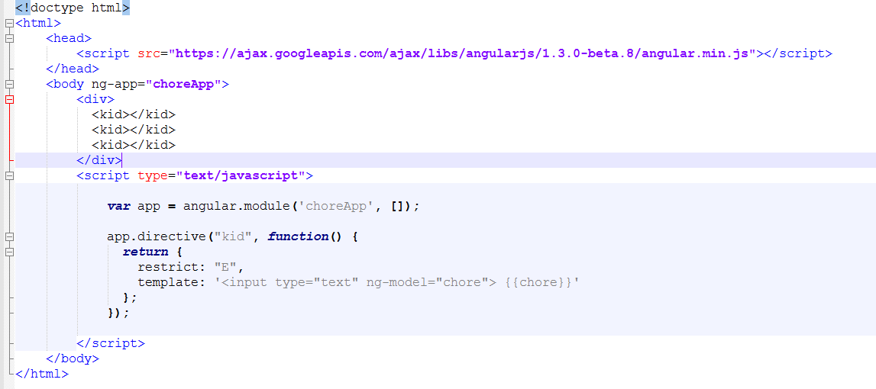
Custom Directive Isolated Scope Problem
Notes:
https://thinkster.io/egghead/understanding-isolate-scope

Slide 94
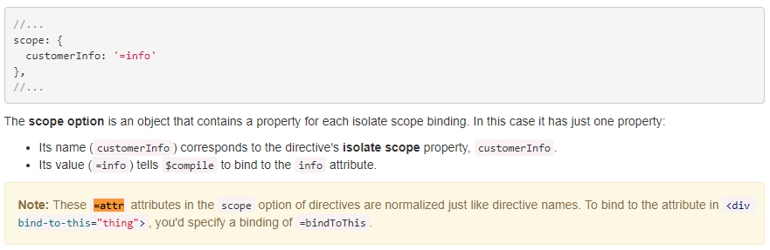
Custom Directive Isolated Scope not-quite Solution
Add “scope : {}” option to have isolated scope
The scope option is an object that contains a property for each isolate scope binding.
Notes:
https://thinkster.io/egghead/understanding-isolate-scope

Slide 95
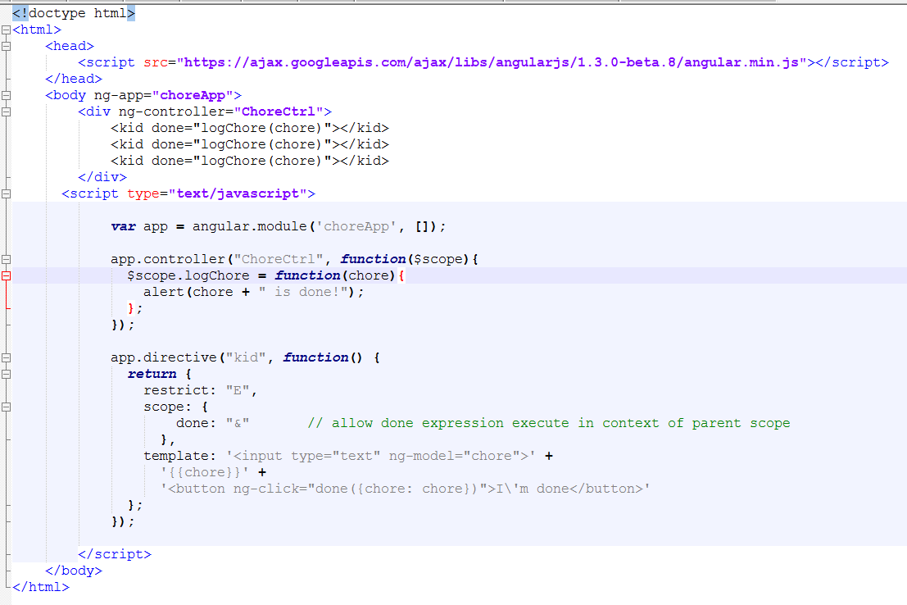
Custom Directive Isolated Scope Final Solution
Notes:
https://thinkster.io/egghead/understanding-isolate-scope

Slide 96
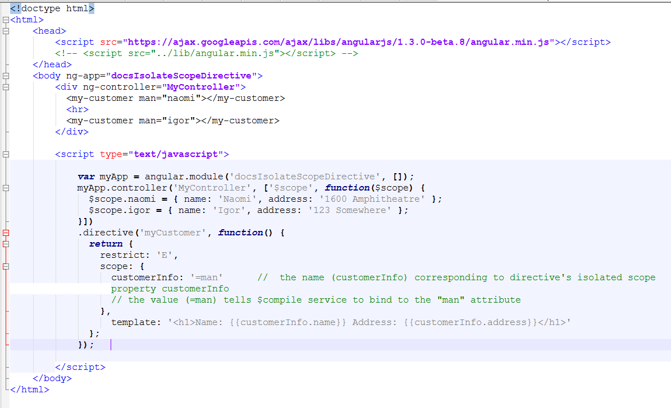
Exercise 7 Isolated scope

Slide 97
Final Homework
Follow the guideline “AJS_Final_Sample_Guideline.docx”

Slide 98
Section 3: Q&A

Slide 99
Thank You!

Slide 100
Revision History
Date | Version | Description | Updated by | Reviewed and Approved By
02 June 2017 | 1.0 | Initial version | Hiep Cao, Tien Tan, Loi Tran
Aug 3rd, 2017 | 2.0 | Re-brand course materials using DXC template | Quang Tran | Quang Tran
Oct 3rd, 2017 | 2.1 | Updated materials: restructure the slide Added the followings: Angular underlying mechanism; Custom directive, scope inheritance, isolated scope; Routing in Angular; form validation; scope events; digest cycle of Angular. | Cuong Chau | Quang Tran

